Slide 1
Contain Your Enthusiasm
A Full Day with Containers and Kubernetes
Jason L. van Brackel
TechBash 2025

Slide 2





CONTACT ME
Jason van Brackel
@JvB
@jasonvanbrackel
jasonvanbrackel
jasonvanbrackel

Slide 3
Agenda
Containers
Docker Essentials
Introduction to Kubernetes
What are Containers
Benefits of Containers
Containers vs. Virtual Machines
Container Runtimes
Container Tools
Exercise – Review and Existing Container with dive
Installing Docker
Docker Commands for Building and Running Containers
Exercise – Building a Container with Docker
Container Orchestration
Why Should Developers Care?
Don’t Run Kubernetes – An Introduction to Kubernetes
Running Kubernetes
Application Deployment
Kubernetes Power Tools
Running Kubernetes Locally
Running Kubernetes in the Cloud
Dealing with Scale
Exercise – Setup K3s
Exercise - Deploying and Exposing and Application with Manifests
Helm
Kustomize
Flux
Exercise – Deploy and Application with Helm
Exercise – GitOps with Flux
K9s
Azure Draft
Don’t Run Kubernetes – An Introduction to Kubernetes

Slide 4
What Are Containers
Containers are lightweight, portable, and self-contained software packages.

Slide 5
What are Containers?
Container Runtime (Docker)
Isolation
Consistency Across Environments
Portability
Application Packaging and Management
App A
App A₁
App A₂
App A₃
App B
App B₁
Server (Host OS)
Server

Slide 6
What’s In a Container
Container Runtime (Docker)
Runtime Environment
System Tools and Libraries
Application Code
Settings and Configuration
App A
App A₁
App A₂
App A₃
App B
App B₁
Server (Host OS)
Server

Slide 7
Containers are not VMs
VM
Containers
App A
App A₁
App B
Windows Server Guest OS
Windows Server Guest OS
Windows Server Guest OS
App A
App A₁
App A₂
App A₃
App B
App B₁
Docker
Hypervisor (Type 1)
Server (Host OS)
Server
Server

Slide 8
Containers are not VMs
VM
Containers
App A
App A₁
App B
App A
App A₁
App A₂
App A₃
App B
App B₁
Docker
App A
App A₁
App A₂
App A₃
App B
App B₁
Docker
App A
App A₁
App A₂
App A₃
App B
App B₁
Docker
Windows Server Guest OS
Windows Server Guest OS
Windows Server Guest OS
Windows Server (Host OS)
Windows Server (Host OS)
Windows Server (Host OS)
Hypervisor (Type 1)
Hypervisor (Type 1)
Server
Server

Slide 9
Container Benefits
Container Runtime (Docker)
Resource Efficient
Scalability and Flexibility
Faster Deployment
Consistent and Reliable
Secure and Isolated
Simplified Management
App A
App A₁
App B
App A
App A₁
App A₂
App A₃
App B
App B₁
Windows Server Guest OS
Windows Server Guest OS
Windows Server Guest OS
Hypervisor (Type 1)
Server (Host OS)
Server
Server

Slide 10
Use Cases
Hypervisor
Containers
Monoliths
Legacy Application
Full OS Isolation Required
Microservices Architecture
Rapid Deployment and Scale

Slide 11
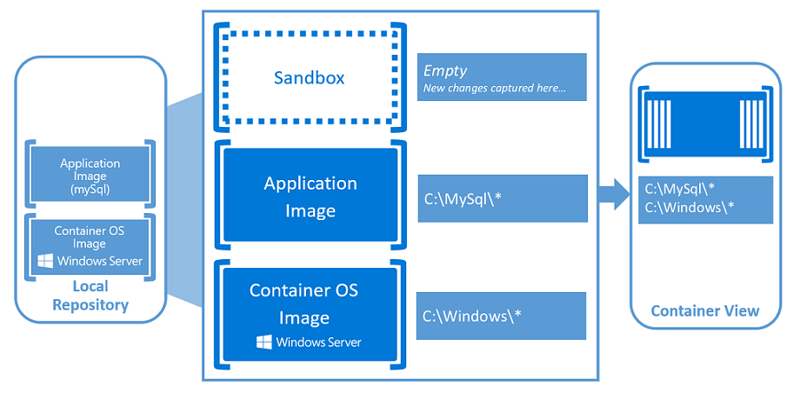
Container Fundamentals
Windows Containers - https://docs.microsoft.com/en-us/virtualization/windowscontainers/about/index

Slide 12
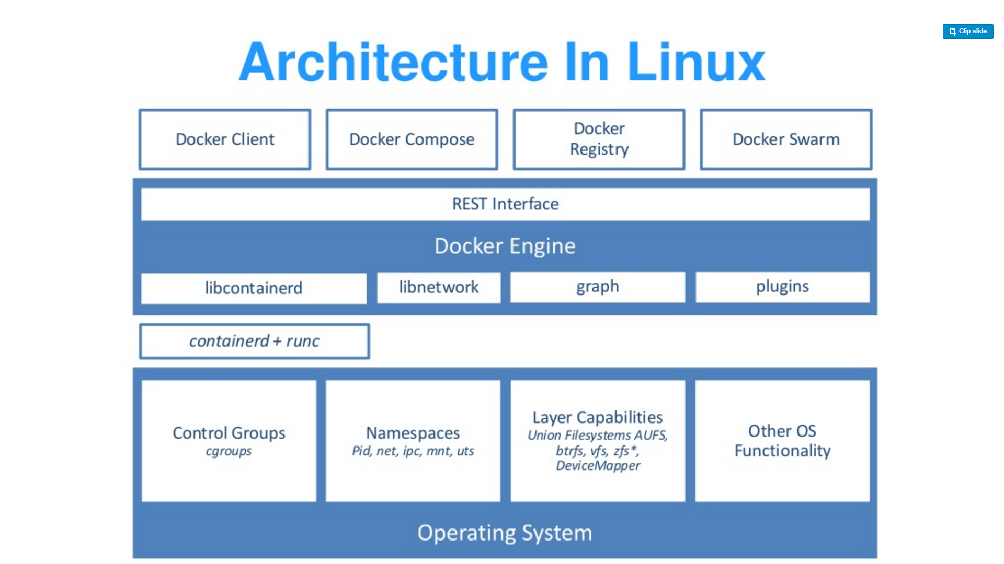
Source: “DockerCon 16: Windows Server & Docker - The Internals Behind Bringing Docker & Containers to Windows - Black Belt”

Slide 13
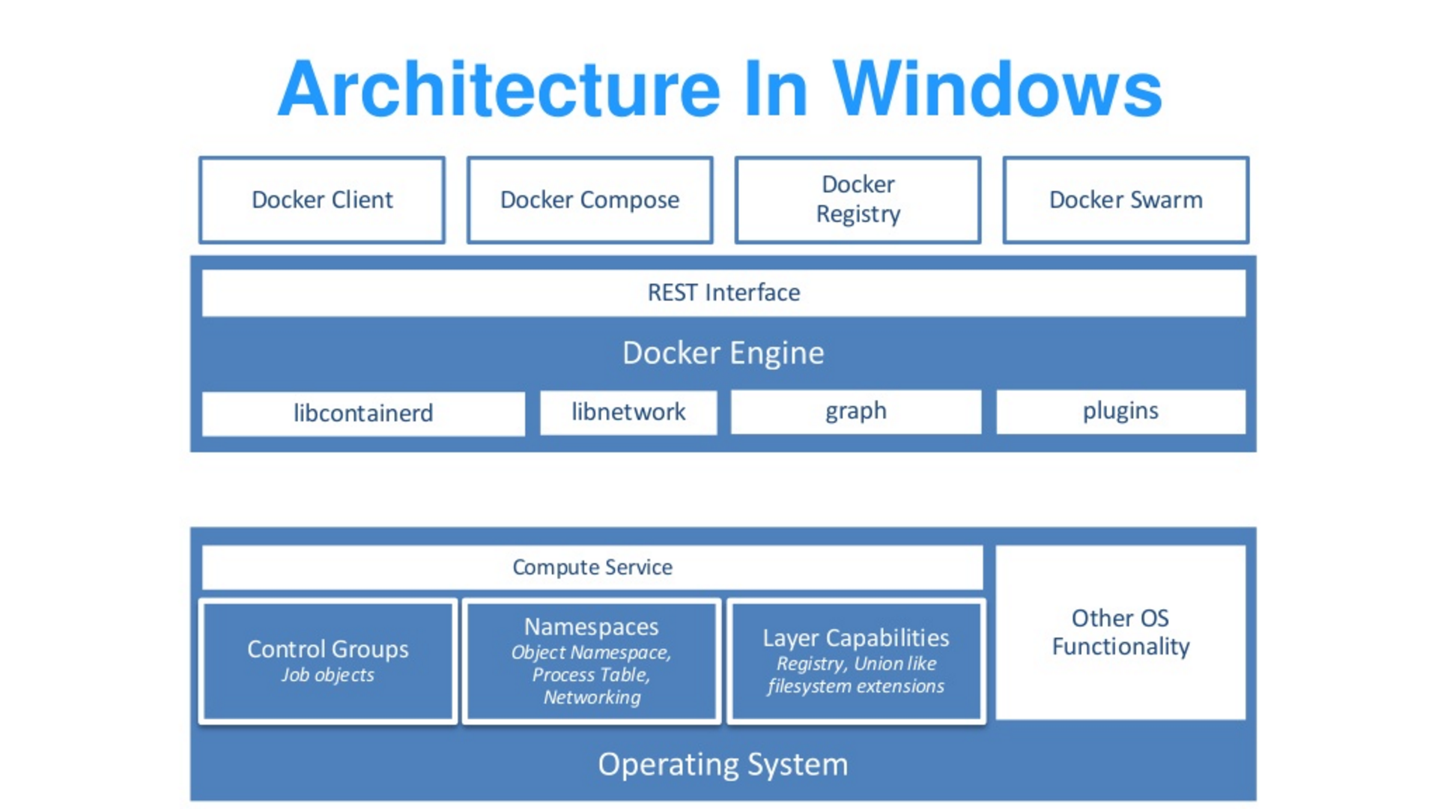
Source: “DockerCon 16: Windows Server & Docker - The Internals Behind Bringing Docker & Containers to Windows - Black Belt”

Slide 14
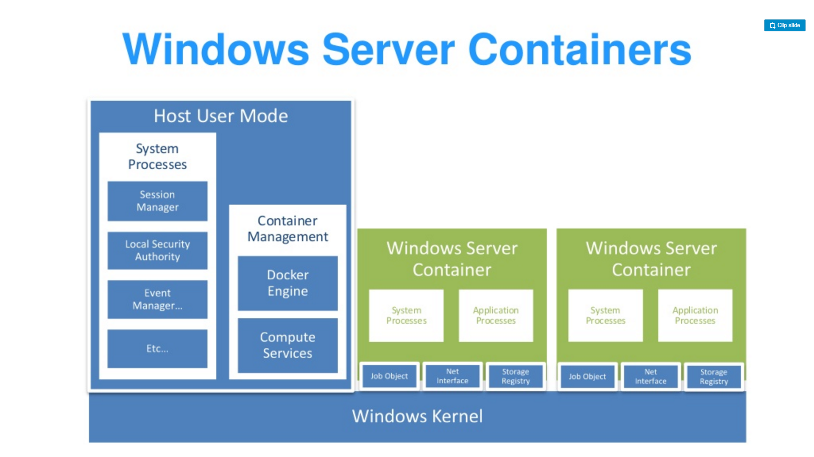
Source: “DockerCon 16: Windows Server & Docker - The Internals Behind Bringing Docker & Containers to Windows - Black Belt”

Slide 15
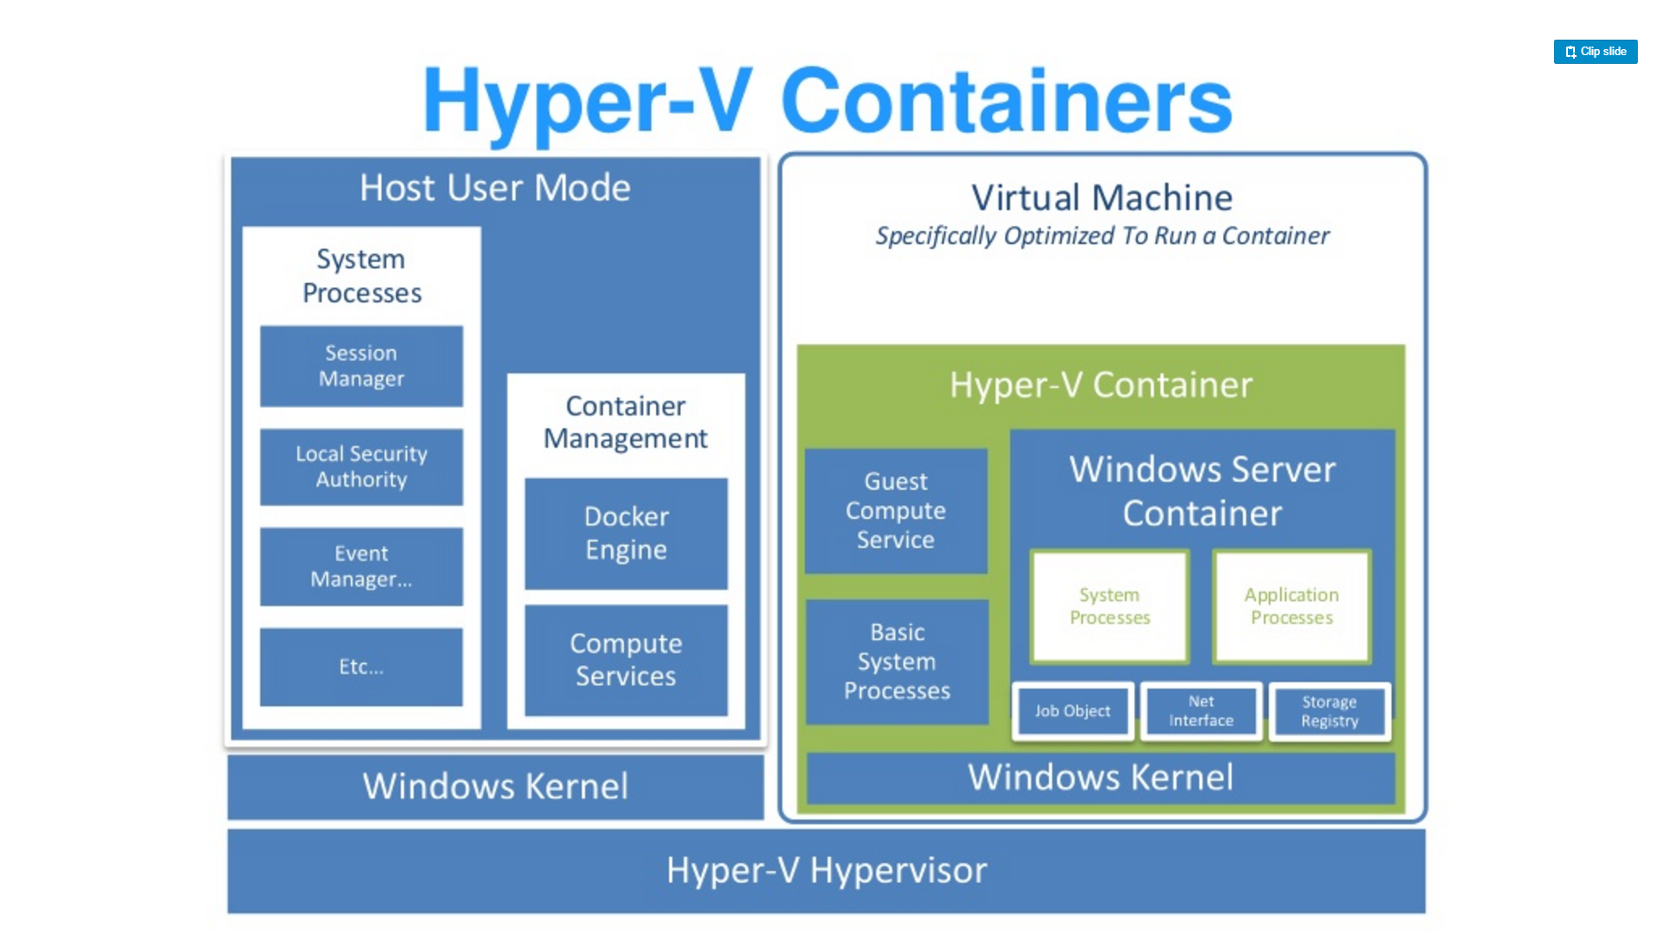
Source: “DockerCon 16: Windows Server & Docker - The Internals Behind Bringing Docker & Containers to Windows - Black Belt”

Slide 16
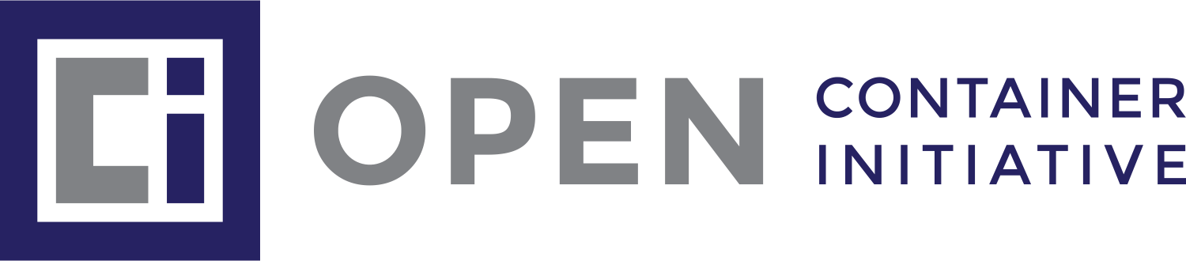
Container Runtimes
Software that executes and manages containers' lifecycle on a host system.
Docker
Podman
containerd

Slide 17
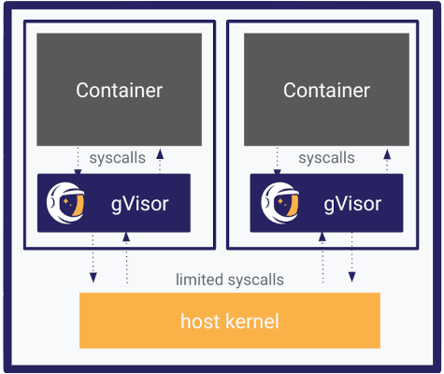
Container Runtimes
Kata Containers
Podman
gVisor

Slide 18
Exercise
Container Exploration with Dive

Slide 19
Installing Docker
https://www.docker.com/
https://mobyproject.org/
https://rancherdesktop.io/

Slide 20
Docker COmmands
https://docs.docker.com/reference/

Slide 21
Exercise
Build a .NET Container

Slide 22
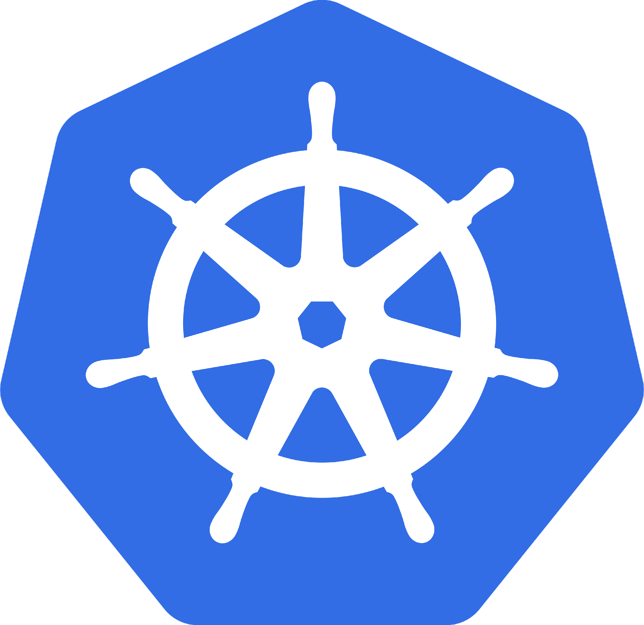
What is Kubernetes
Orchestrates
Containers

Slide 23
What is Kubernetes
Orchestrates
Containers
Storage
Infrastructure

Slide 24
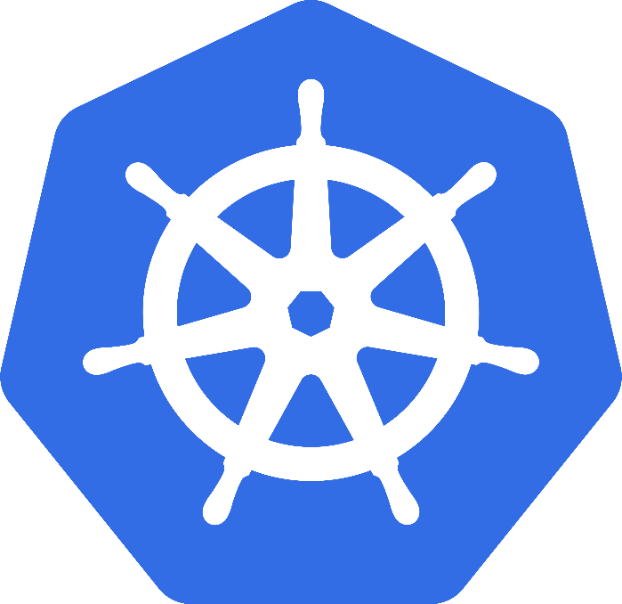
Kubernetes
Greek for “Helmsman”; also the root of the word “Governor”
Google’s 3rd Container Platform (Borg, Omega)
Set of compossable building blocks
Container orchestrator
Runs Docker / Rkt / Linux containers / Windows Containers
Supports multiple cloud and bare-metal environments
Built on lessons learned from Borg and Omega
Written in Go
Manage applications, not machines
Kubernetes SIG-Windows
Notes:
Omega: Raw State Omega: Multiple Schedulers, Compossable building blocks

Slide 25
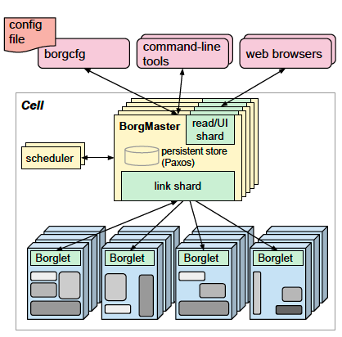
Kubernetes Lineage Google Borg
Runs hundreds of thousands of jobs..
..for many thousands of different applications (YouTube, Search Index, Maps, etc.)..
..across a number of clusters (hundreds)..
..each with up to tens of thousands of machines..
Borg currently manages many millions of physical servers hosting billions of containers!
In production since 2003!
Offers a declarative job specification language, name service integration, real-time job monitoring, and tools to analyze and simulate system behavior.
Source: Large-scale cluster management at Google with Borg

Slide 26
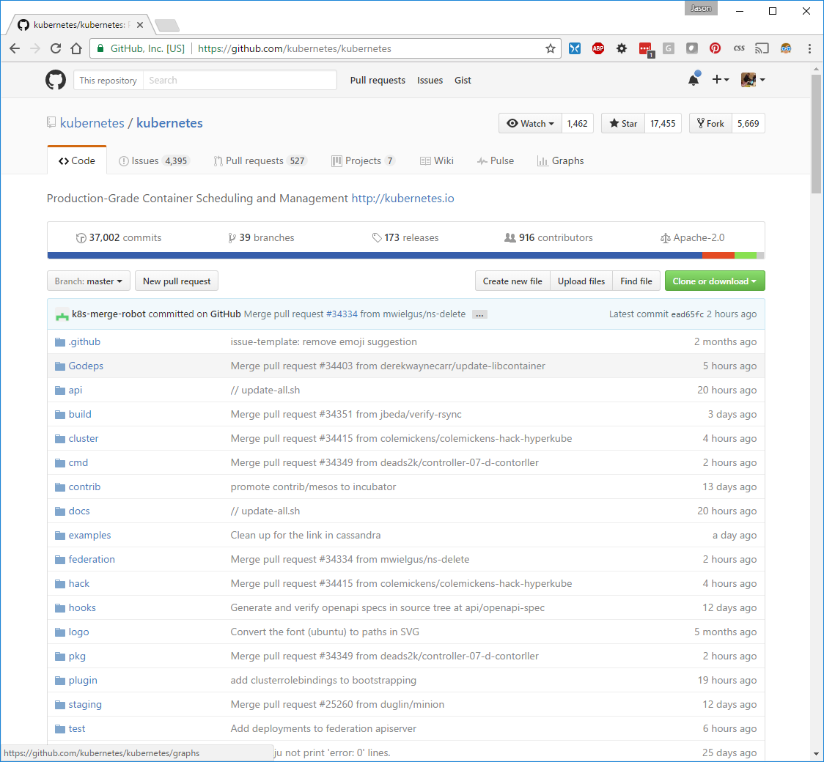

Slide 27
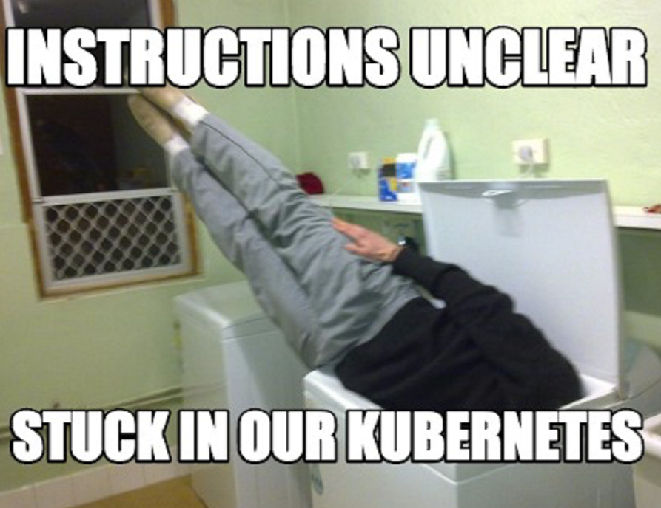
It Is Complex
Scale
Kubernetes Reference API
What is Kubernetes Physically Speaking?

Slide 28
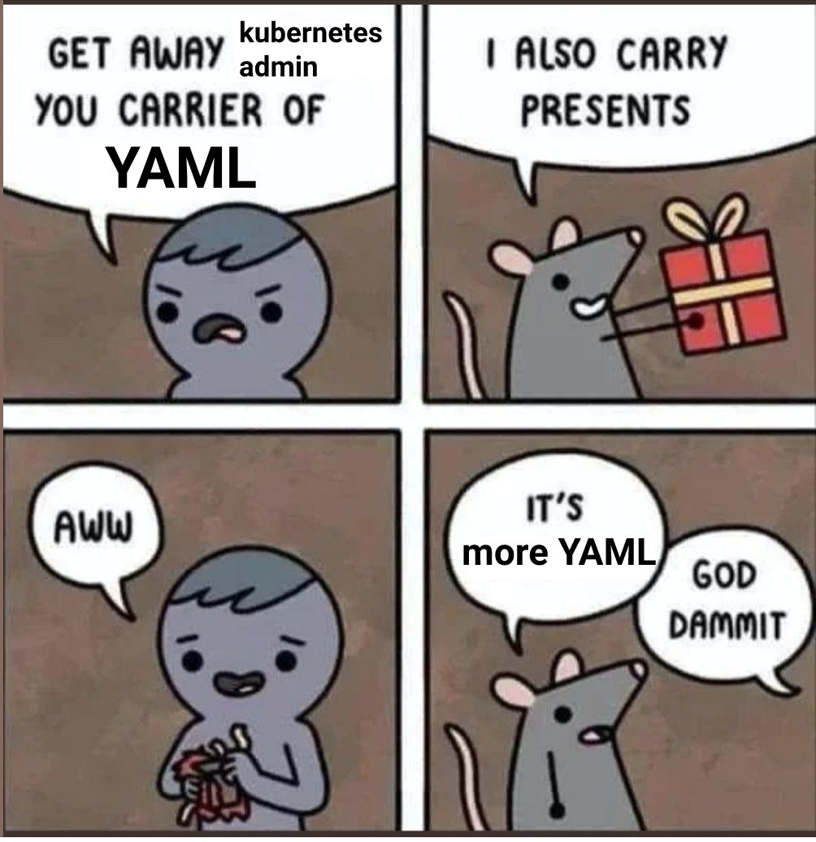
It Is Complex
https://twitter.com/memenetes/status/1633876132855709697

Slide 29
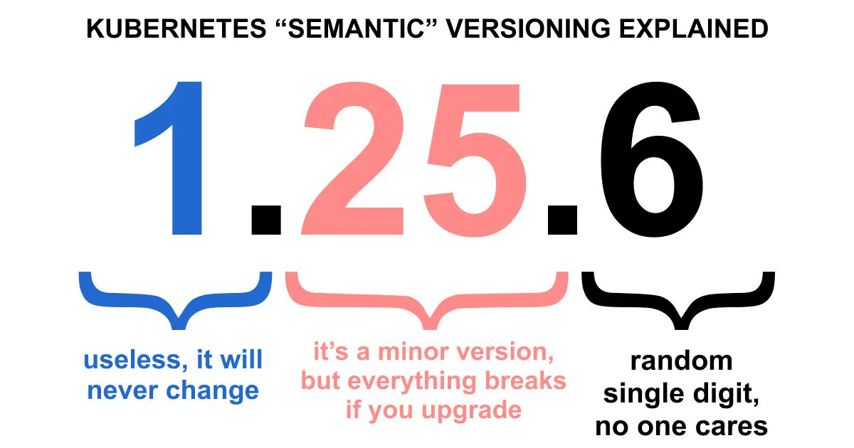
It Is Complex
https://twitter.com/memenetes/status/1631339227785969664

Slide 30
Key Concepts
Container: An application package (Docker / Podman)
Pod: A small group of tightly coupled Containers
Controller: A loop that drives current state towards desired state
Service: A set of running pods that work together
Labels: Identifying metadata attached to other objects
Selector: A query against labels, producing a set result
Secret: Hide stuff

Slide 31
Why Should I care?
Developers
Operators
It’s Everwhere

Slide 32
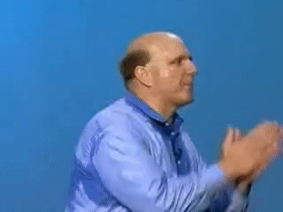
Why Should Developers care?
Containerized Applications
Breaking the Monolith
It’s the Substrate

Slide 33
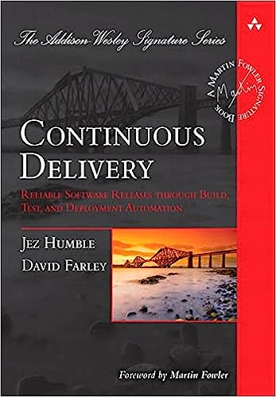
Why Should Developers care?
12 Factor Methodology
Microservice Architecture

Slide 34
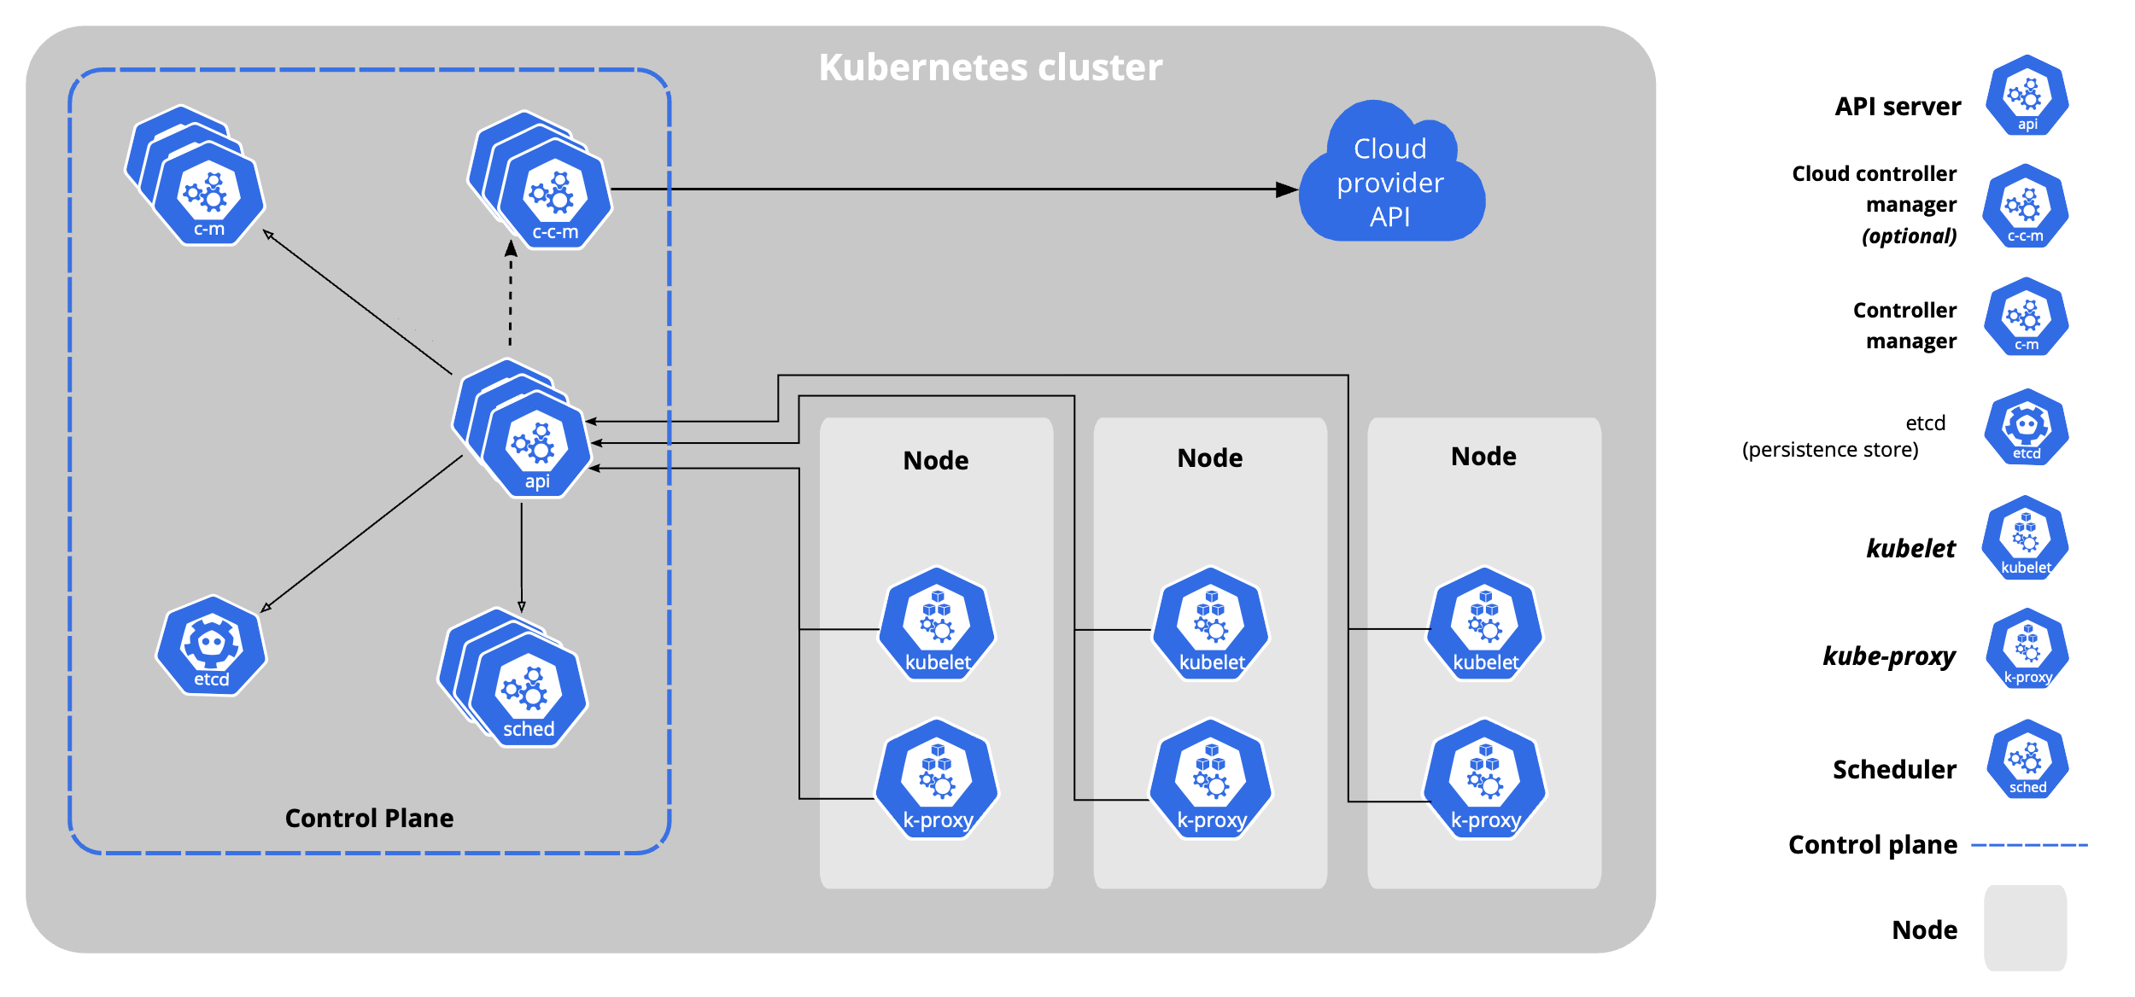
https://kubernetes.io/docs/concepts/architecture/cloud-controller/#design

Slide 35
Don’t run kubernetes

Slide 36
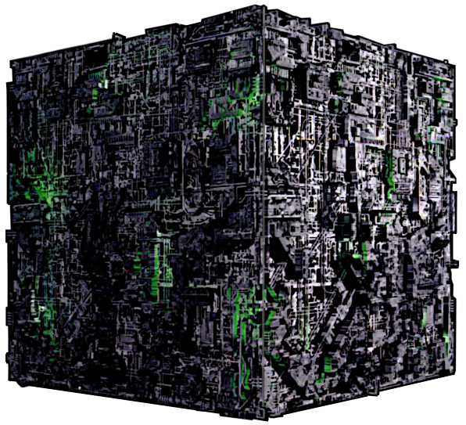
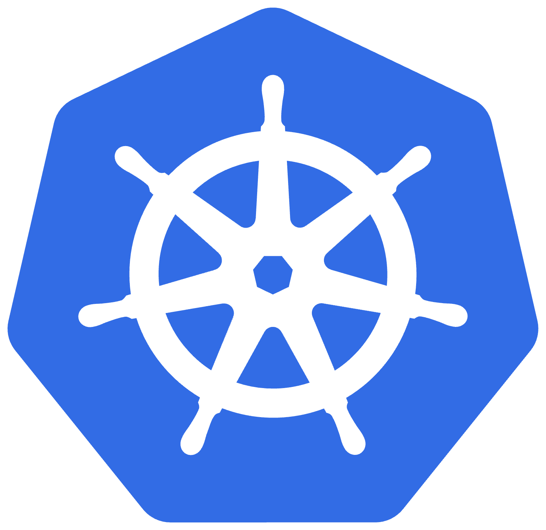
Ω
Large-scale cluster management at Google with Borg - https://research.google/pubs/pub43438/
Borg, Omega, and Kubernetes - https://research.google/pubs/pub44843/

Slide 37
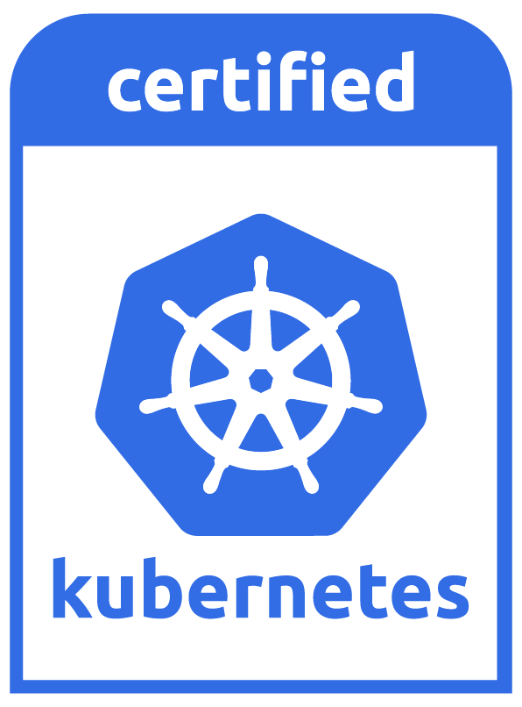
What does it do?
Automated rollouts and rollbacks
Service discovery and load balancing
Service Topology
Storage orchestration
Secret and configuration management
Automatic bin packing
Batch execution
IPv4/IPv6 dual-stack
Horizontal scaling
Self-healing

Slide 38

K8s Is Hard!
Kubernetes

Slide 39

K8s Is Hard!
Kubernetes

Slide 40


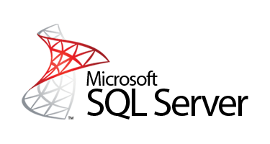
K8s Is Hard!
Kubernetes
Underlying CRI

Slide 41
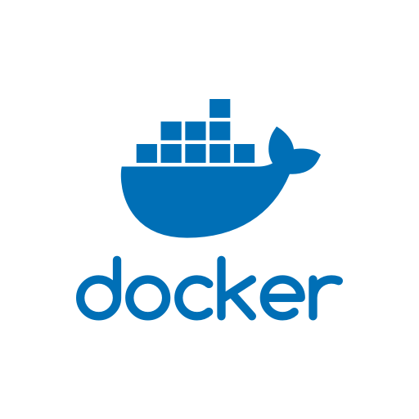
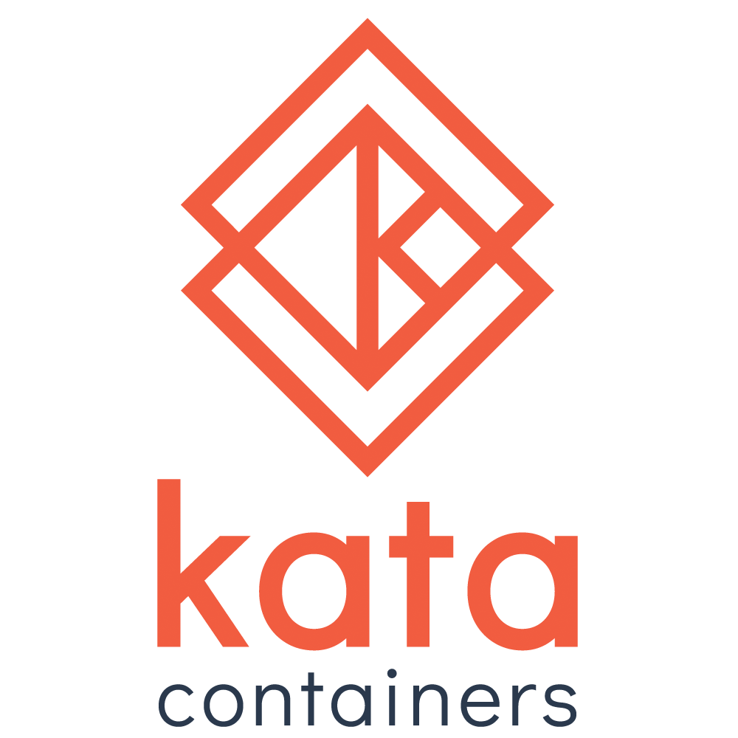

K8s Is Hard!
Kubernetes
Underlying CRI

Slide 42




K8s Is Hard!
Kubernetes
Underlying CRI
Underlying CNI

Slide 43
What does it do?
Automated rollouts and rollbacks
Service discovery and load balancing
Service Topology
Storage orchestration
Secret and configuration management
Automatic bin packing
Batch execution
IPv4/IPv6 dual-stack
Horizontal scaling
Self-healing

Slide 44
K8s IS Hard!
Application Migration
API Gateway / Service Mesh
Logging
Observability
Persistence
CI/CD
Compliance
Container Registries

Slide 45
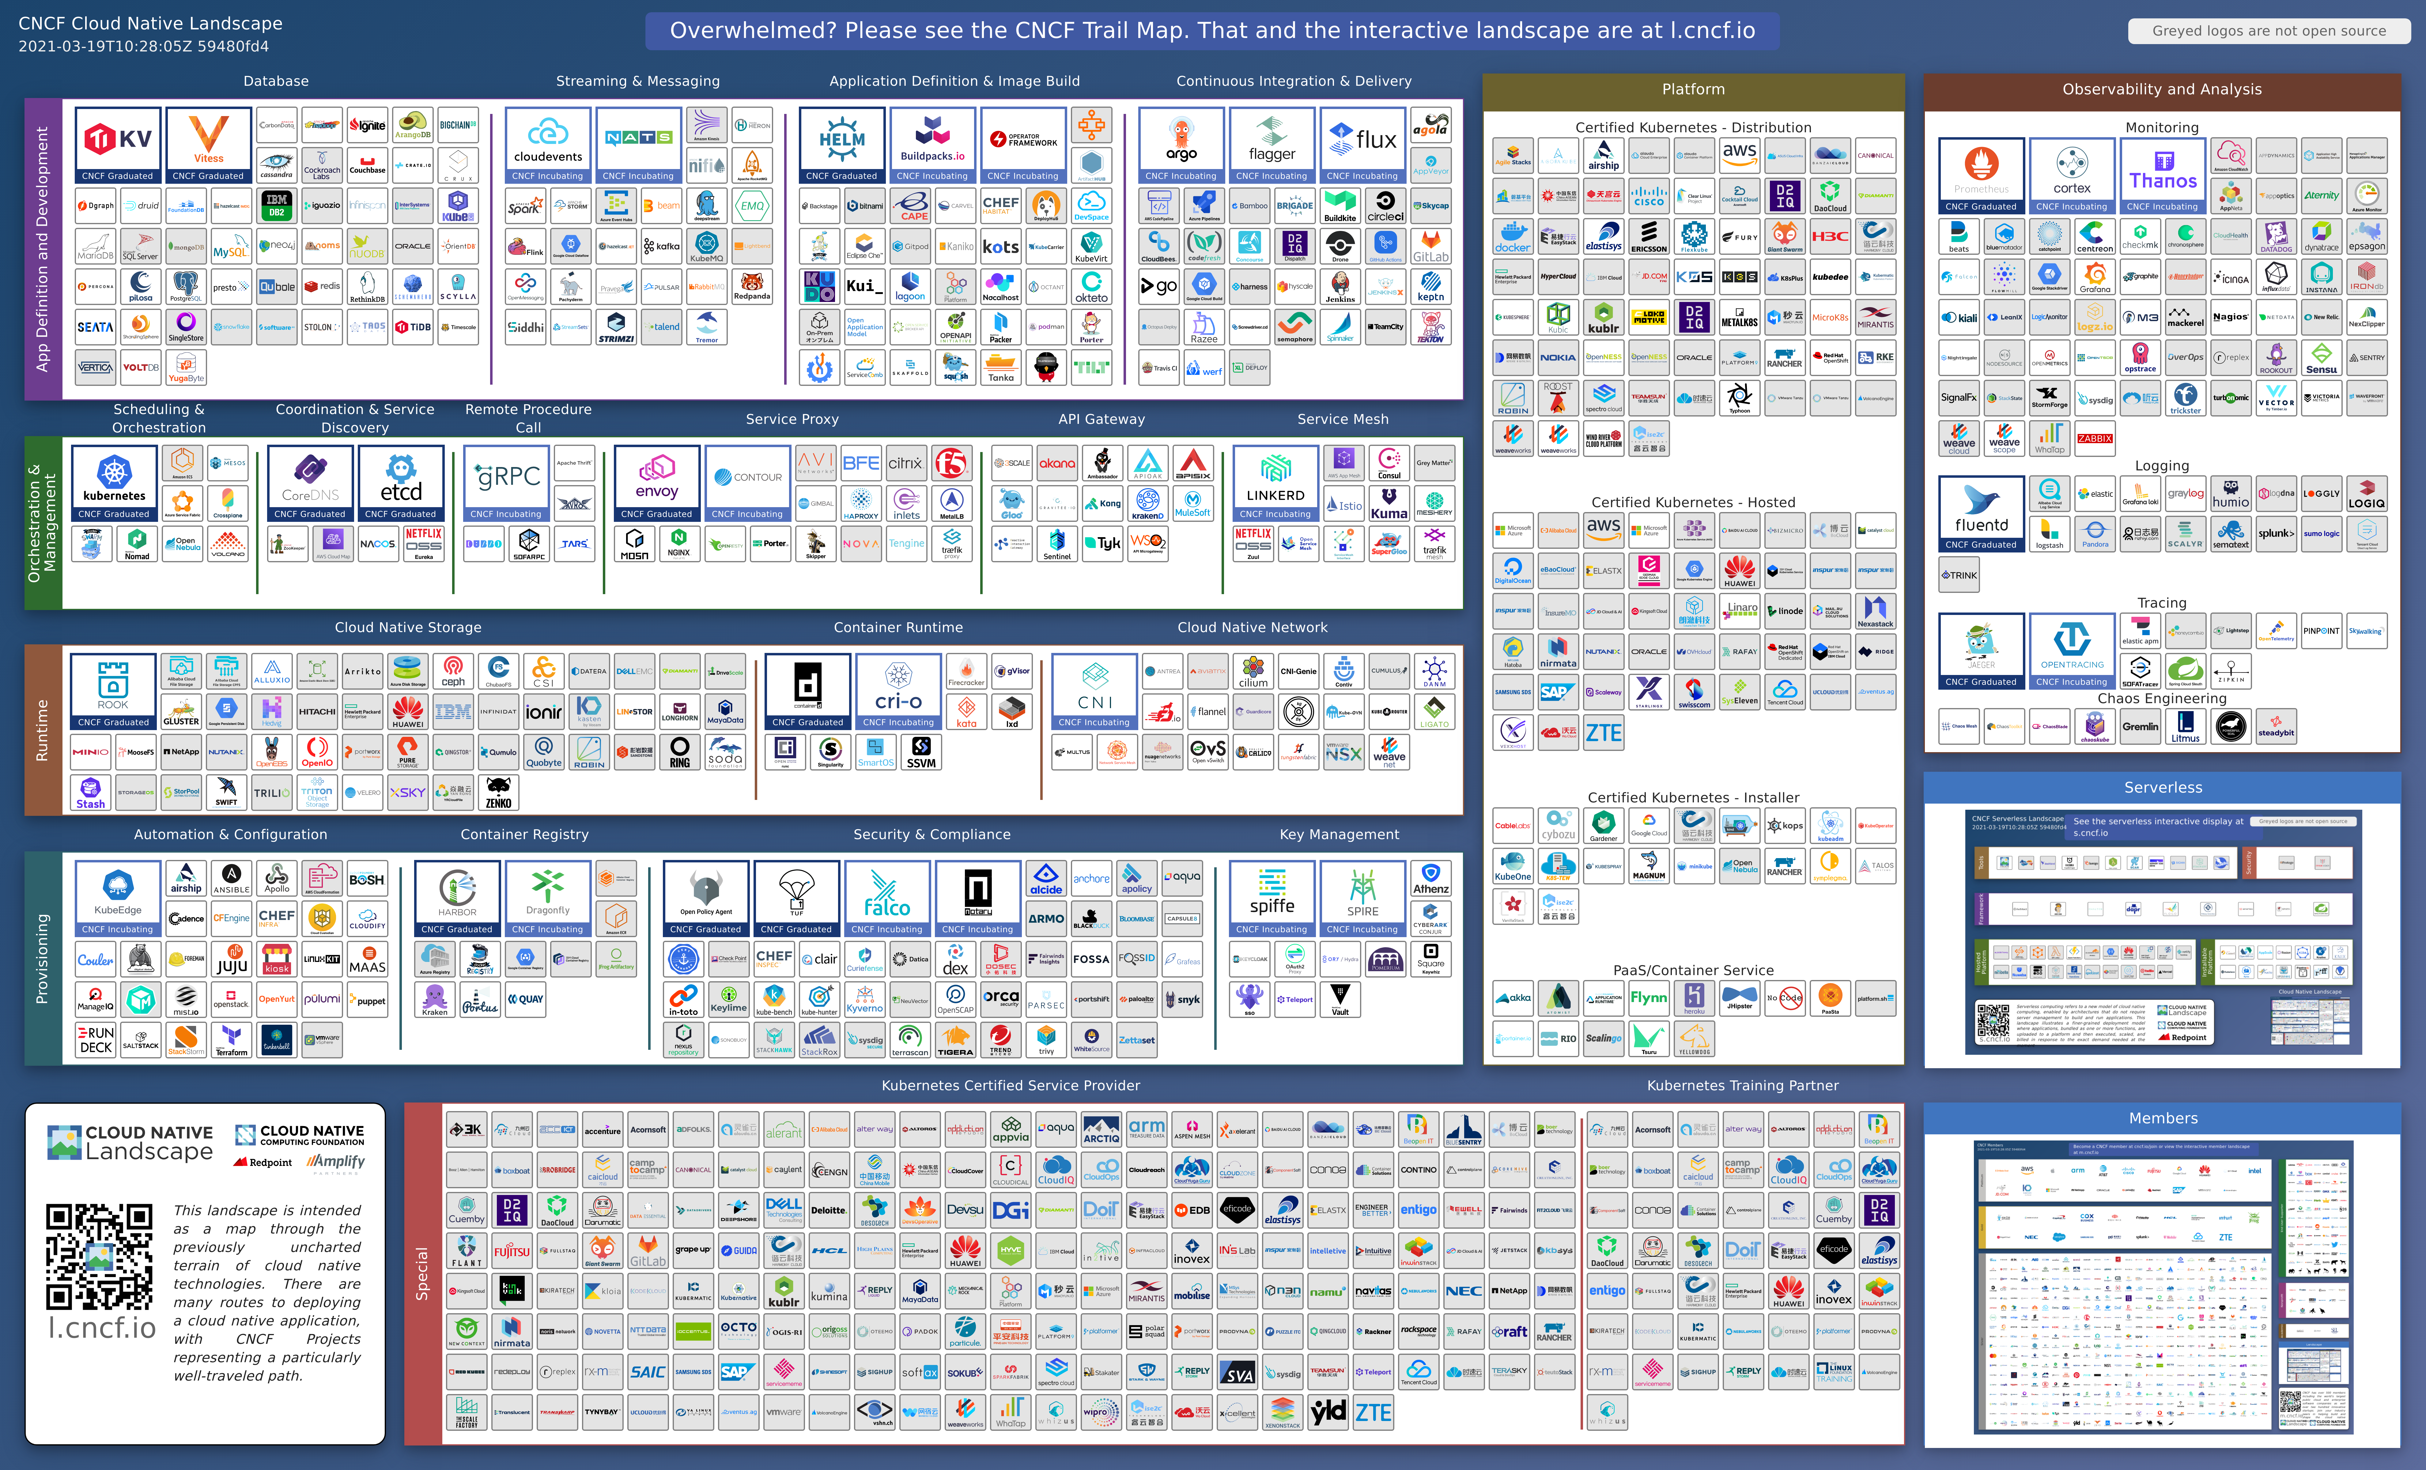

Slide 46
Application Migration

Slide 47
API Gateway & Service Mesh

Slide 48
Logging

Slide 49
Observability

Slide 50
Persistence and Storage

Slide 51
CI/CD

Slide 52
Compliance

Slide 53
Container Registries

Slide 54
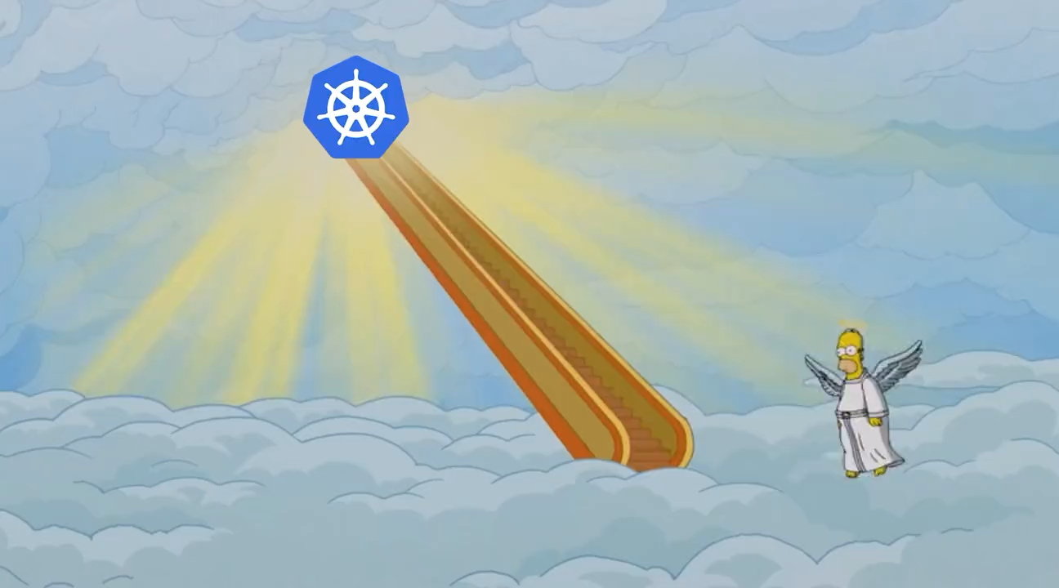
The Kitchen Sink
https://landscape.cncf.io/
https://twitter.com/memenetes/status/1637861860039876624

Slide 55
Let’s Take a Look At a Couple
Rancher Kubernetes - CNCF Cloud Native Interactive Landscape
k3s - CNCF Cloud Native Interactive Landscape
Red Hat OpenShift - CNCF Cloud Native Interactive Landscape

Slide 56
When should Use K8s?
You’re Running Massive Scale
You Write Large Scale Distributed Microservices
Your Company Isn’t Giving You a Choice

Slide 57
When Should I Run K8s?
Airgap is Required
Hybrid Cloud Scenarios
Regulatory Need
You’re Experienced
Your Company Isn’t Giving You a Choice

Slide 58
Which Distribution Should I Choose?
Strong User Base
Commercial Support
CNCF Certified Kubernetes
Open Source vs. Open Core

Slide 59



Which Distribution Should I Choose?
https://k3s.io
https://docs.rke2.io/
https://www.openshift.com/

Slide 60

Which Distribution Should I Choose?
https://www.rancher.com/
https://www.openshift.com/

Slide 61
Which Service Should I Choose?
Open Source?
Existing Contracts
Existing Relationships
Regulatory Concerns
SLAs
CNCF Certified Kubernetes

Slide 62
What is generally not an issue
Cost
Uptime
Speed
Extra Features
Upgrades

Slide 63
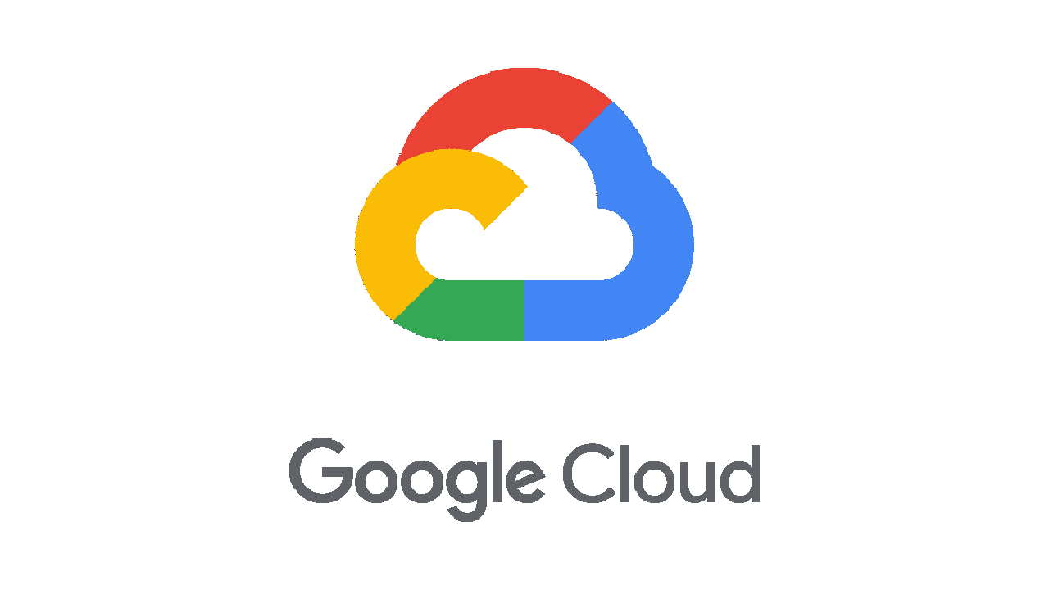


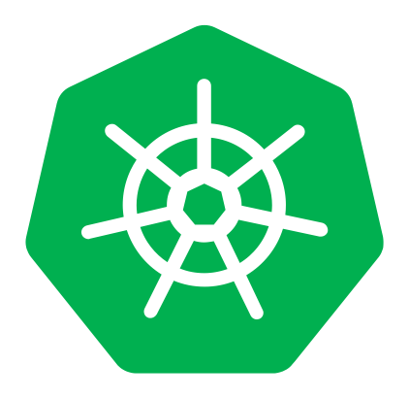
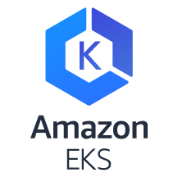
Personal Ranking
Major Cloud Providers
Smaller Cloud Providers

Slide 64
Kubernetes Concepts

Slide 65
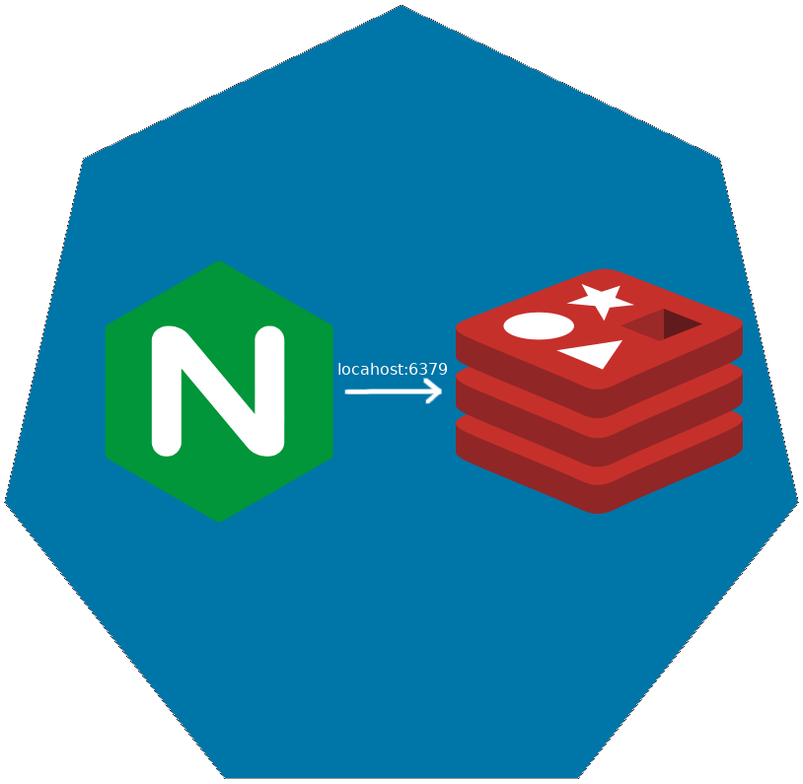
Pod
Co-scheduled
Shared Network Namespace
Shared Files System

Slide 66

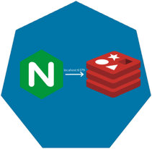
ReplicaSet

Slide 67

ReplicaSet

Slide 68
ReplicaSet

Slide 69
Deployments

Slide 70
Deployments

Slide 71
Deployments

Slide 72
Deployments

Slide 73
Deployments

Slide 74
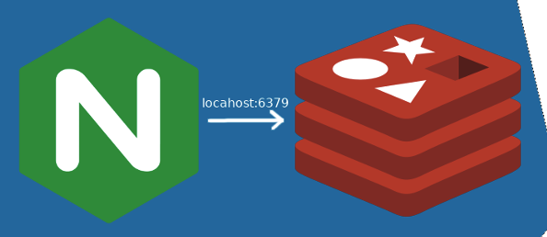
How are these Connected?
Deployment
Deployment
ReplicaSet
ReplicaSet
Manages
Manages
Manages
Manages
Pod
Pod
Manages
Manages
Containers
Containers

Slide 75
How are these Connected?
Deployment
Deployment
ReplicaSet
ReplicaSet
Selector
app=nginx
Pod
Selector
app=nginx
Labels
app=nginx
Labels
app=nginx
Labels
app=nginx
Selector
app=nginx
Pod
Selector
app=nginx
Labels
app=nginx
Containers
Containers

Slide 76
How are these Connected?
Deployment
Deployment
ReplicaSet
ReplicaSet
Selector
app=nginx
Pod
Selector
app=nginx
Labels
app=nginx
Labels
app=nginx
Labels
app=nginx
Selector
app=nginx
Pod
Selector
app=whatevs
Labels
app=whatevs
Containers
Containers

Slide 77
Services
Define a DNS entry that can be used to refer to a group of pods
Provide a consistent endpoint for the group of pods
Different types: nodePort, clusterIP, loadbalancer
#rancherk8s

Slide 78

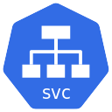
Services (Node Port)
192.168.0.[1-3]:32000

Slide 79
Services (Load Balancer)
Public IP:80

Slide 80
Config Maps & Secrets
Allow storing of arbitrary configuration values and files
Exposed in pods as either environment variables or as local storage
Decoupled storage of configuration from pod spec
#rancherk8s

Slide 81
Config Maps & Secrets
apiVersion: v1
kind: ConfigMap
metadata:
name: dev-config
namespace: default
data:
Item1: dev-stuff
Item2: more dev stuff
apiVersion: v1
kind: ConfigMap
metadata:
name: qa-config
namespace: default
data:
Item1: qa-stuff
Item2: more qa stuff
apiVersion: v1
kind: ConfigMap
metadata:
name: prod-config
namespace: default
data:
Item1: prod-stuff
Item2: more prod stuff

Slide 82
Ingresses
Define how traffic outside the cluster is routed to inside the cluster
Used to expose Kubernetes services to the world
Route traffic to internal services based on factors such as host and path
Ingress is usually implemented by a load balancer (Nginx, HAProxy, AWS ELB, etc…)
#rancherk8s

Slide 83

Ingresses
Ingress Controller
https://my-nginx-app.cluster.com https://cluster.com/my-nginx-app

Slide 84
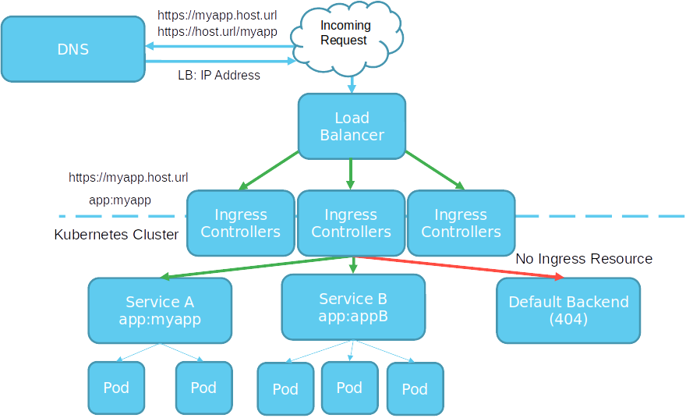

Slide 85
Tools
Running Kubernetes Locally
Running Kubernetes In The Cloud
Dealing with Scale

Slide 86
Running Kubernetes Locally
K3s
K3d
Rancher
Docker
Kind
KWOK

Slide 87
Running Kubernetes In the Cloud
AKS
EKS
GKE
Digital Ocean
Linode

Slide 88
Dealing with Scale
Find a framework you like
ELK
PLG
Don’t Over Alert

Slide 89
Exercise
Deploy K3s

Slide 90
Packaging and Supply Chain Security
Chainguard
Zarf

Slide 91
Application Deployment
Helm
Kustomize
Zarf

Slide 92

What is Helm?
Helm helps you manage Kuberentes-based applications via charts
Features
Install
Upgrade
Rollback
Delete

Slide 93
What is Helm?
Charts include
Kubernetes API Definiton templates for the application
Configurable Values
Chart metadata for publishing
https://helm.sh

Slide 94
Exercise
Deploy an Application with Helm

Slide 95

What is Zarf?
Zarf
Zarf is an always free, open source product that makes air-gap easy for Kubernetes.

Slide 96
Zarf
CLI
Tools for deploying and managing applications in air-gapped environments
Package
Inspect
SBOM
Deploy

Slide 97
Zarf Packages
Packages
Are the single tarball that contains everything needed to deploy your payload to its desired destination.
Defined by zarf.yaml
Two flavors

Slide 98
Zarf Packages
Packages
Zarf Packages
Zarf Init Packages
injector
registry seed
container registry
Optional
K3s
logging
git server

Slide 99
Zarf Components
Components
Make up a Package
Files, Helm Charts, Manifests, Images, Git Repos, Scripts, Data

Slide 100
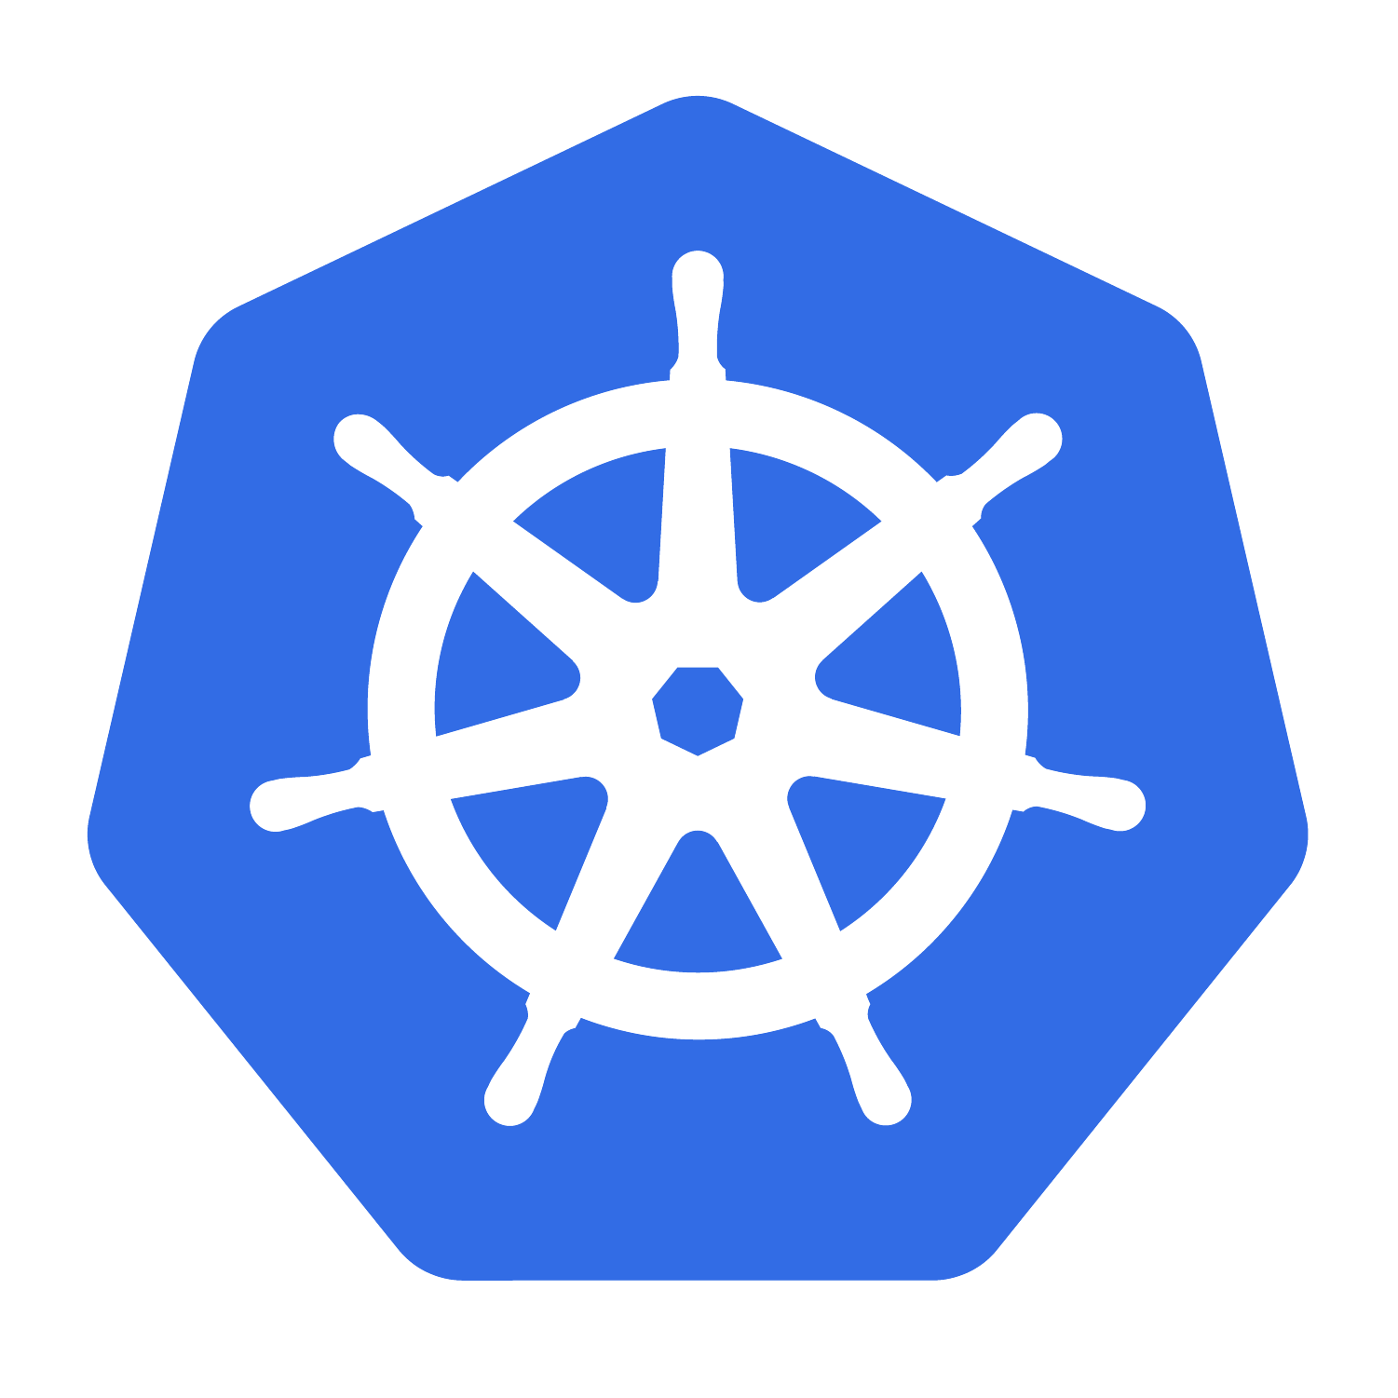




Overview
Define
Package
Transport
Deploy
You Declaratively define your payload
Zarf Securly Packages, Charts, Manifests, Images, and Files
You transport your package over the wire, over the road.
Zarf deploys and verifies your payload to Kubernetes

Slide 101
What do we mean by Securely Package?

Slide 102
What is a Software Bill of Materials?
SBOM
A Software Bill of Materials is an inventory of the components used in the construction of a software artifact.
It is used to help secure software supply chains. And is a tool in software supply chain risk management.

Slide 103
What is a Software Bill of Materials?
SBOM
Formal
Machine Readable
May Include OSS and Proprietary Software

Slide 104
What is a Software Bill of Materials?
Components
Provenance
Keys
Signatures
Attestations

Slide 105
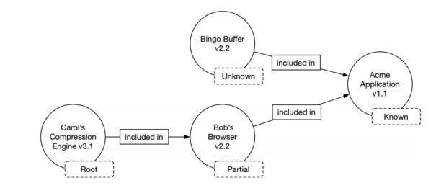
What is Provenance?
Provenance
Formal
Machine Readable
May Include OSS and Proprietary Software
https://ntia.gov/files/ntia/publications/sbom_at_a_glance_apr2021.pdf

Slide 106
KEY PAIRS
Keys
Public Key
Private Key

Slide 107
Signing
Signed Artifacts
Source Code
Binary Artifacts
Container Images

Slide 108
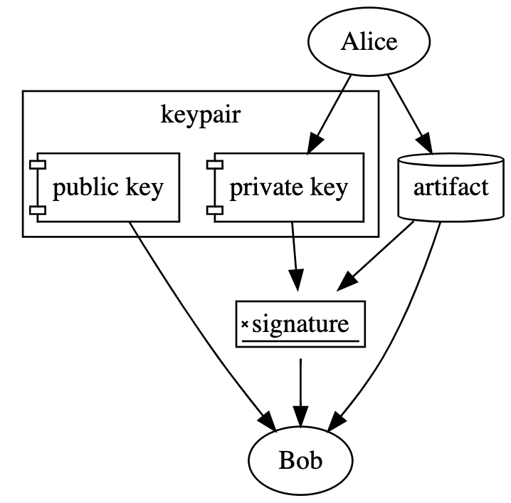
Signing
What is a Signature
https://dlorenc.medium.com/policy-and-attestations-89650fd6f4fa

Slide 109
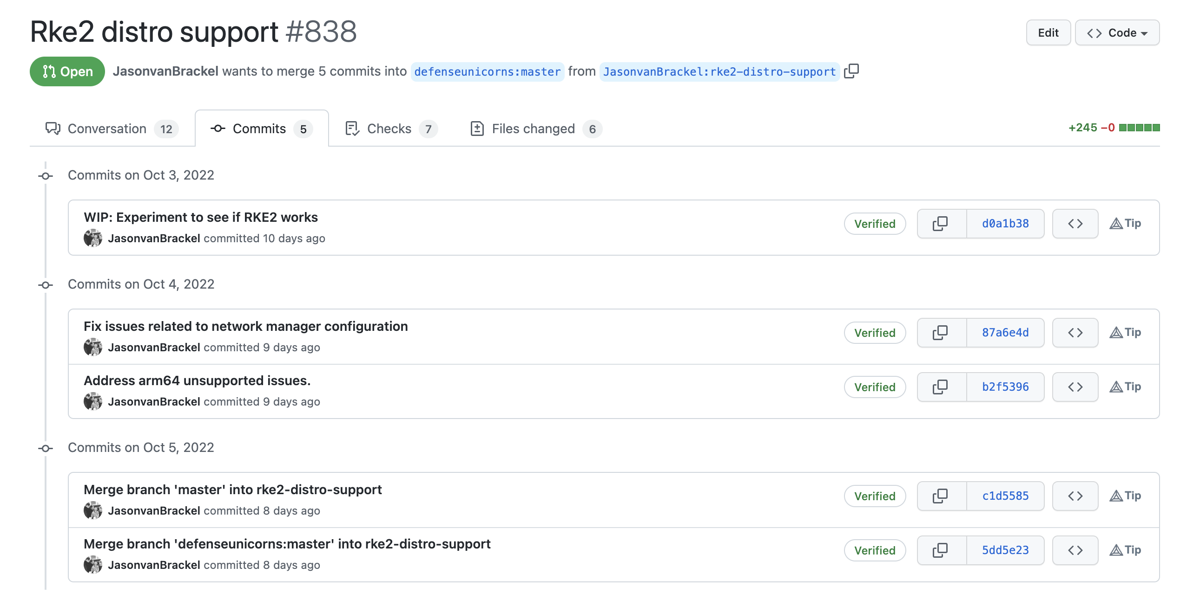
Signing
Signed Artifacts
Source Code
Binary Artifacts
Container Images

Slide 110
Signing
Signed Artifacts
Source Code
Binary Artifacts
Container Images

Slide 111
What is an attestation?
We need more
What checks were performed?
What quality gates were checked?
What about CVEs?
What was done?
When was it done?

Slide 112
Attestation
What is an Attestation?
Makes verifiable claims about provenance
Can include tests and test results.
Can tell you what scans were done
Can make claims about authorization for which automated policy decsions can be made.

Slide 113
Signing
What is a Signature
https://dlorenc.medium.com/policy-and-attestations-89650fd6f4fa

Slide 114
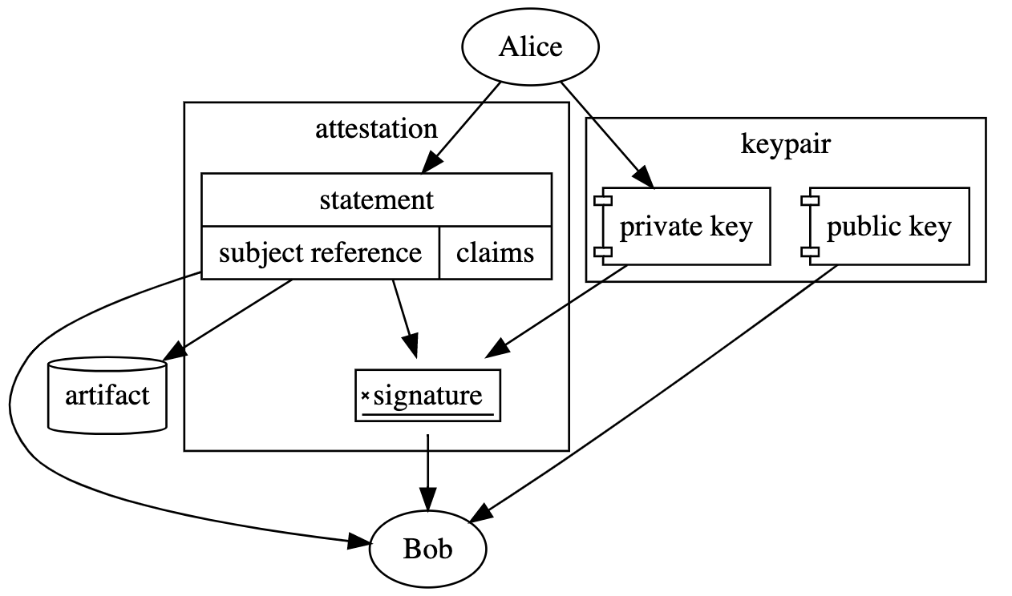
Attestation
What is an Attestation?
https://dlorenc.medium.com/policy-and-attestations-89650fd6f4fa

Slide 115
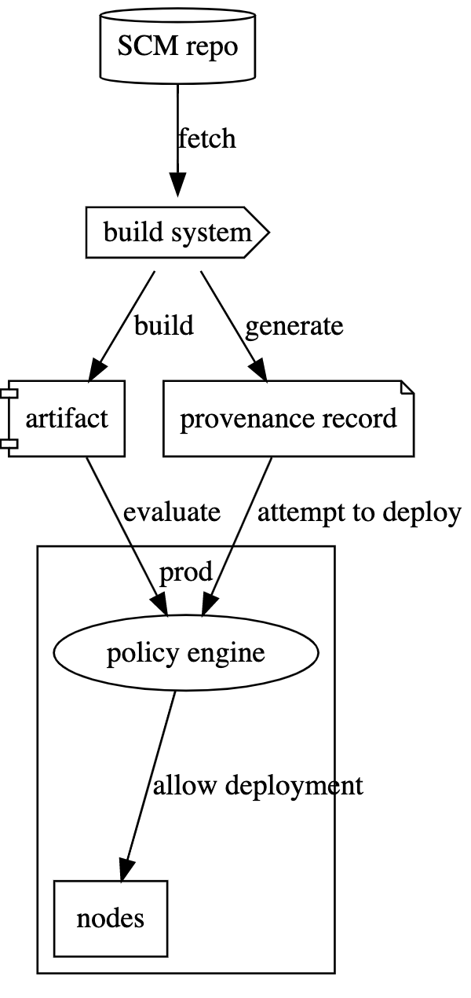
The Big Picture

Slide 116
Zarf Exercise
Demo Time!
https://docs.zarf.dev/tutorials/3-deploy-a-retro-arcade/

Slide 117

What is Draft?
Draft extends Helm to help you bootstrap configuration for Kubernetes based applications.
Features
Create
Upgrade
Connect

Slide 118
What is Draft?
Draft creates boilerplate scaffolds.
Draft supports
Java
Node
DotNet (Core)
Go
And more

Slide 119
Power Tools
K9s
Azure Draft
Dive

Slide 120
Understanding Storage in Kubernetes

Slide 121
Agenda
Storage APIs in Kubernetes
Volumes
EmptyDir
Host
Files
Config Maps
Secrets
Persistent Volumes
Provisioning
Static
Dynamic
Usage
Storage Options
Cloud
On-Premises
CSI

Slide 122
Storage APIs in Kubernetes
Configuration
ConfigMap
Secret
Storage
Volume
VolumeMount
PersistentVolume
PersistentVolumeClaim
StorageClass
VolumeAttachment

Slide 123
Volume
Solves Two Problems
Container Death
File Sharing
Lifetime of the Pod that encloses it.

Slide 124
Volume – Volume Types
awsElasticBlockStore
azureDisk
azureFile
cephfs
configMap
csi
downwardAPI
emptyDir
fc (fibre channel)
flocker
gcePersistentDisk
gitRepo (deprecated)
glusterfs
hostPath
iscsi
local
nfs
persistentVolumeClaim
projected
portworxVolume
quobyte
rbd
scaleIO
secret
storageos
vsphereVolume

Slide 125
Volume – Volume Types
Ephemeral Volumes
API Objects
Mounted Host Files & Directories
External Storage
Life of underlying files varies
Read the Docs

Slide 126
Volume – Volume Types
In-tree
Out-of-tree
FlexVolume
CSI

Slide 127
Volume – Volume Types
In-tree
Out-of-tree
FlexVolume
CSI
Linked, Compiled build and Shipped with Kubernetes

Slide 128
Volume – Volume Types
In-tree
Out-of-tree
FlexVolume
CSI
Requires Access to the Root Filesystem on control plane and worker nodes
Difficult to Deploy
External Dependencies

Slide 129
Volume – Volume Types
In-tree
Out-of-tree
FlexVolume
CSI
Standardized Mechanism
Side-cars provided to connect CSI drivers with Kubernetes
Alpha in 1.9, Beta since 1.10

Slide 130
Example 1
EmptyDir (Ephemeral)
ConfigMap (API Object)
HostDir (Mounted Host File)
NFS Share (External Storage)

Slide 131
Persistent Volumes
Represent distinct storage provisioned by an administrator (static) or Provisioner (dynamic)
Lifecycle independent of Pods

Slide 132
Persistent Volume – Volume Types
GCEPersistentDisk
AWSElasticBlockStore
AzureFile
AzureDisk
FC (Fibre Channel)
Flexvolume
Flocker
NFS
iSCSI
RBD (Ceph Block Device)
CephFS
Cinder (OpenStack block storage)
Glusterfs
VsphereVolume
Quobyte Volumes
HostPath (Single node testing only – local storage is not supported in any way and WILL NOT WORK in a multi-node cluster)
Portworx Volumes
ScaleIO Volumes
StorageOS

Slide 133
Persistent Volume – Volume Types
Some can be resized (beta)
Mount Options Vary
Read the Docs

Slide 134
Persistent Volume – Life cycle
Available
Bound
Released
Failed
A free PV that is not bound to a claim

Slide 135
Persistent Volume – Life cycle
Available
Bound
Released
Failed
The PV is bound to a PVC.

Slide 136
Persistent Volume – Life cycle
Available
Bound
Released
Failed
The claim has been deleted, but the PV is not yet reclaimed by the cluster.

Slide 137
Persistent Volume – Life cycle
Available
Bound
Released
Failed
Automatic reclamation has failed.

Slide 138
Persistent Volume – Reclaim Policy
Retain
Recycle
Delete
Manual reclamation of resources.

Slide 139
Persistent Volume – Reclaim Policy
Retain
Recycle
Delete
Deprecated – Largely unsupported. Don’t use it.

Slide 140
Persistent Volume – Reclaim Policy
Retain
Recycle
Delete
Underlying storage mechanism is deleted.

Slide 141
Storage Class
Gives an administrator the ability to create different storage offerings.
Can be attached to statically provisioned PVs or trigger the dynamic provisioning of PVs.

Slide 142
Storage Class – Internal Provisioners
AWSElasticBlockStore
AzureFile
AzureDisk
Cinder
Flocker
GCEPersistentDisk
GlusterFS
Quobyte
RBD
VsphereVolume
PortworxVolume
ScaleIO
StorageOS

Slide 143
Storage Class – External Provisioners
AWS – EFS
Ceph
Digital Ocean
Flex
Gluster
iSCSI
local-volume
NFS
NFS-Client
OpenEBS
https://github.com/kubernetes-incubator/external-storage

Slide 144
Example 2
Storage Class
Statically Provisioned
Dynamically Provisioned Storage

Slide 145
The Kitchen Sink
https://landscape.cncf.io/

Slide 146
ANY QUESTIONS?

Slide 147
CONTACT ME
Jason van Brackel
@JvB
@jasonvanbrackel
jasonvanbrackel

